Slide 1
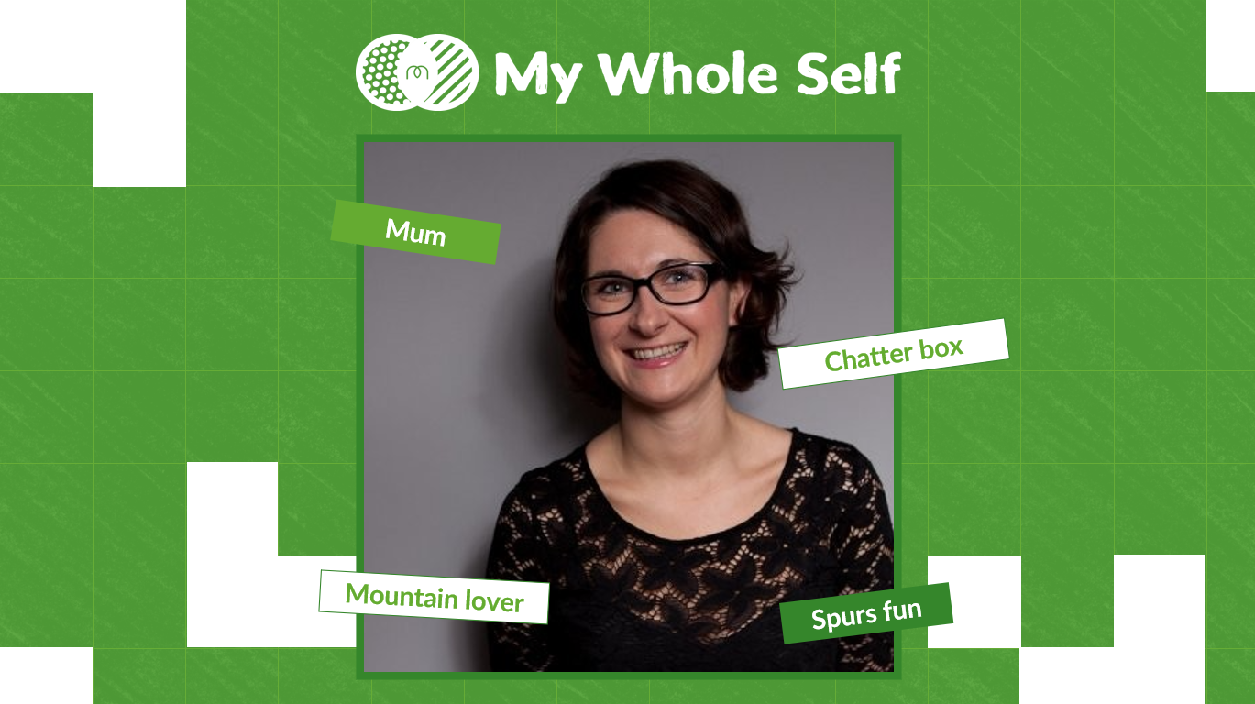
How to create and share your My Whole Selfie
Before creating your My Whole Selfie, download this PowerPoint file locally, please do not edit directly here.
Using the template, upload your selfie into the square (If it needs adjusting, go to ‘picture format’ and ‘crop’
Using the text descriptor boxes, add text that describes your whole self
Go to File > Save as, and select ‘JPEG File Interchange Format’
Click ‘save’
When asked ‘Which slide do you want to export?’ click ‘Just This One’
Share on Instagram, LinkedIn, Twitter, or Facebook
Example
Notes:
1

Slide 2
Insert descriptor
Insert descriptor
Insert descriptor
Insert descriptor
Insert descriptor
Insert descriptor

Slide 3
Insert descriptor
Insert descriptor
Insert descriptor
Insert descriptor
Insert descriptor
Insert descriptor

