Slide 1


Campaign toolkit
Brought to you by Mental Health First Aid England®
© MHFA England 2025

Slide 2
Overview
This campaign toolkit has been developed to support you and your organisation to get involved with My Whole Self, the campaign for workplace culture change.
It includes template email and website copy for you to share with your people, social media banners and signatures, and even guidance on sharing your story with the media.
Whether you take part in My Whole Self Day or throughout the year, we hope you will join us in changing workplace cultures for the better.

Slide 3
Engaging your people

Slide 4
Engaging your people
For My Whole Self to be a success in your organisation, your people need to be on board
To help get the message out there we have developed a suite of content:
Internal email copy that you can edit for use
Signature banners to add to your emails
Social media graphics which you can use across your digital channels

Slide 5
Email copy
[Organisation name] is proud to be supporting My Whole Self, MHFA England®’s campaign for workplace culture change.
The campaign calls on organisations to empower employees to bring their whole self to work. Bringing your whole self to work means feeling empowered and comfortable to bring all parts of your identity to work, including your background, sexuality, religion, gender, physical and mental health.
By bringing together diversity and inclusion with health and wellbeing, we hope to drive positive transformation in workplace mental health and performance. Teams that feel safe and connected work better together. We want you to feel psychologically safe, seen, heard and valued which is why we have decided to get involved.

Slide 6
Email copy cont.
To mark My Whole Self Day, on 11 March 2025 we will be [insert details of activities that you will be doing and any joining instructions]. If you would like to find out more about the campaign and take a look at some of the resources, visit My Whole Self.

Slide 7

Signature banners
Ask your people to add this to their email signature to demonstrate your commitment to the campaign
Email signature

Slide 8
Be part of the conversation online

Slide 9
Be part of the conversation online
We’ve drafted some suggested social media posts so you can share your support for My Whole Self with your online community:​
Don’t forget to share your #MyWholeSelfie as well. You can find instructions here.
How will you celebrate #MyWholeSelf Day on 11 March? Get your free resources from @MHFAEngland's website now and start planning what your workplace can do to empower everyone to bring their whole selves to work https://bit.ly/3Ps3Pgs
How can we create mentally healthy workplaces? It starts when we can bring our ‘whole self’ to work. On 11 March workplaces across the country will celebrate My Whole Self Day – download free resources now to get involved https://bit.ly/3Ps3Pgs

Slide 10
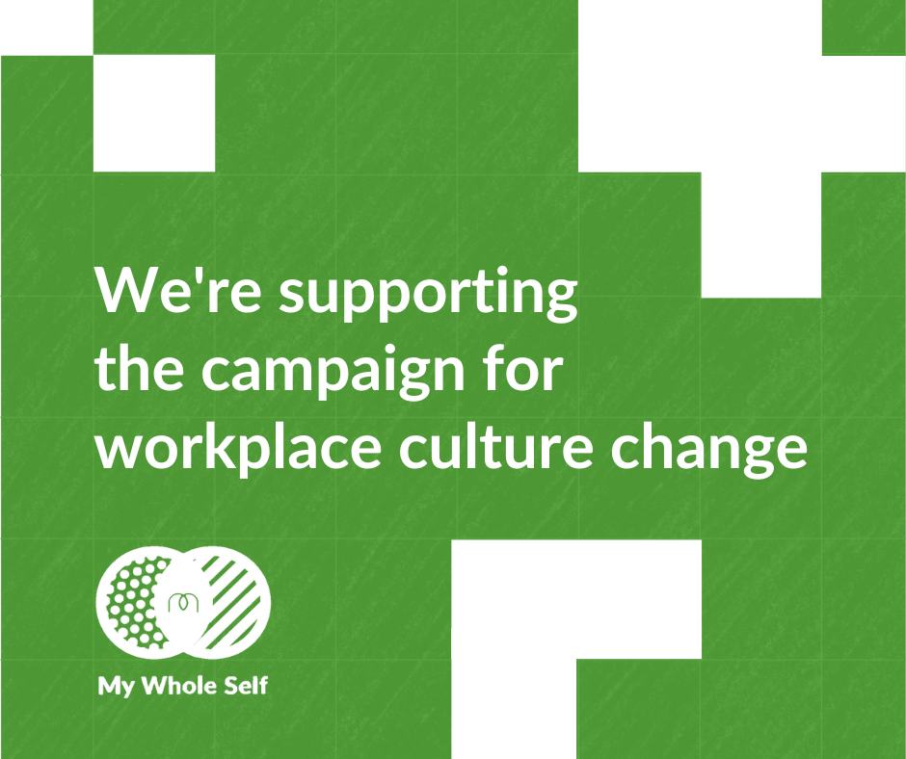
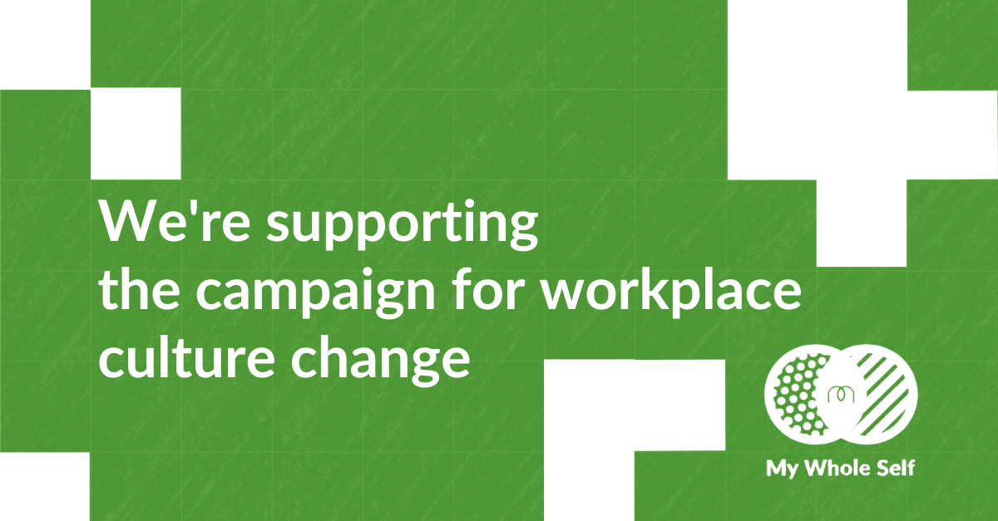
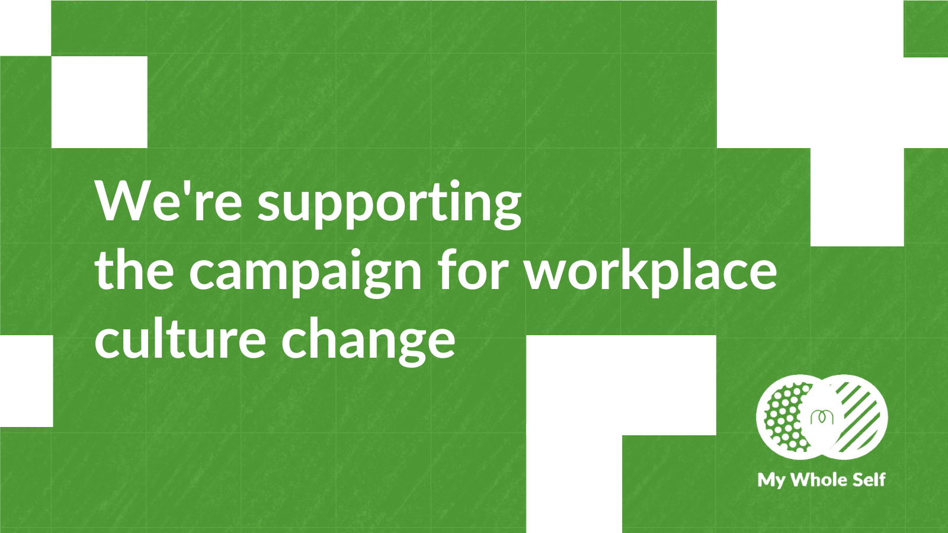
Join the conversation online: Use our social cards​
Download these by clicking on the links below.​
Instagram​
LinkedIn​
Facebook​
X​

Slide 11
Share your story

Slide 12
Share your story
We want you to celebrate your efforts to change workplace culture
The following can help you share your stories and with others:
Website copy
Blogs
Template press release

Slide 13
Website copy
[Organisation name] is proud to be supporting My Whole Self, MHFA England®’s campaign for workplace culture change.
The campaign calls on organisations to empower employees to bring their whole self to work. Bringing your whole self to work means feeling empowered and comfortable to bring all parts of your identity to work, including your background, sexuality, religion, gender, physical and mental health.
By bringing together diversity and inclusion with health and wellbeing, we hope to drive positive transformation in workplace mental health and performance. Teams that feel safe and connected work better together. We want our people to feel psychologically safe, seen, heard and valued which is why we have decided to get involved.

Slide 14
Website copy cont.
[Consider including a quote from a senior leader or someone in your HR team about why you are getting involved]
To mark My Whole Self Day, we will be [insert details of activities that you will be doing]. If you would like to find out more about the campaign and take a look at some of the resources, visit My Whole Self · MHFA England.

Slide 15
Blogs
A blog can be a great way to start sharing your people’s My Whole Self stories
Why not see if your senior leadership team would be happy to share a bit more about their whole self and their role in celebrating My Whole Self Day
If you are hosting a panel conversation, someone could take notes and develop blog content from it?

Slide 16
Media opportunities
Sharing your involvement with My Whole Self is a great way to spread positive news about your organisation and your people
It’s likely that local and trade media will be most interested in your story
We have put together a template press release over the next few slides which you can copy and paste, and edit as needed to support your outreach

Slide 17
Template press release
New year, no energy? Only 17% of employees feel like going to work each day, reveals new research
New research from Mental Health First Aid England® shows only 17% of employees feel like going to work each day
1 in 10 employees say they never feel inspired by their job and less than a quarter (23%) feel enthusiastic about their job daily
As part of My Whole Self - the campaign for workplace culture change – social enterprise MHFA England® is calling on employers to get to know their people better to help improve employee wellbeing and boost productivity.
New research from Mental Health First Aid England®, released ahead of so-called ‘Blue Monday, reveals that only 17% of employees feel motivated to go to work each day. 1 in 10 employees say they never feel inspired by their job, and less than a quarter (23%) feel enthusiastic daily.

Slide 18
Template press release
MHFA England’s latest research, among 2,000 employees, shows a significant number of workers feel a lack of inspiration and enthusiasm at work. While ‘Blue Monday’ is often billed as the ‘most depressing’ day of the year, the reality is poor mental health and low workplace engagement can affect anyone, at any time.
These figures highlight just how important it is for employers to get to know their people. By taking time to understand your workforce - who they are and what drives them – employers can build cultures where employees are engaged, valued and performing at their best.
The research also reveals junior managers are more likely to be unhappy and demotivated at work compared to their colleagues. 1 in 5 (19%) junior managers say they don’t feel appreciated for the work they do and 22% say they never feel inspired by their job. Only 4% of junior managers say they are bursting with energy at work each day. If managers are feeling undervalued, what hope is there for their teams? This dissatisfaction points to a systemic need for workplaces to change their approach.

Slide 19
Template press release
To empower workplaces to better support and motivate their people MHFA England has today published My Whole Self: My plan for working well. It is a personal, proactive tool to help employees and managers identify what keeps them and their colleagues working well. The plan helps to create psychological safety, one of the key drivers of motivation, engagement and performance. By fostering psychologically safe workplace cultures, wellbeing, morale and productivity will soar. Teams thrive when all voices are encouraged to speak up with ideas, questions, and concerns, or admit mistakes, without fear of judgement or consequence
MHFA England wants workplaces where everyone is safe to bring their whole self to work, if they choose to. My Whole Self provides a range of free tools to help organisations prioritise psychological safety. MHFA England has developed a range of My Whole Self activities and resources for employers to use throughout the year, for leaders HR, managers and employees.

Slide 20
Template press release
Workplaces are being encouraged to take part in My Whole Self Day on 11 March 2025 and start planning their activities now. They can access the new, free resource, as well as others, including the My Whole Self MOT and the My Whole Self: Managers’ Toolkit, to help build understanding of their employees’ lived experiences and identities and develop psychological safety.
Sarah McIntosh, Chief Executive of MHFA England, said:
“We all have days when we’re feeling less inspired and motivated at work, but MHFA England’s latest research shows that for many employees, especially junior managers, this is happening too often, and it is impacting our energy levels, wellbeing and performance at work.
So, what can employers do to mitigate these worrying trends? It’s simple. Understanding your people is the key to motivation and wellbeing. My Whole Self offers employers the tools to create thriving workplaces and support employers on their journey to creating high performing and happier workforces. This investment in wellbeing isn’t just good for people—it’s good for business.”

Slide 21
Template press release
Dr. Melissa Carr, Director of Equity, Diversity, and Inclusion at the World of Work Institute, Henley Business School, adds:
“While organisations are striving to foster inclusive environments, there is still work to be done, particularly in supporting junior managers.
This research highlights how junior managers are struggling to feel energised and engaged at work, which is critical for their wellbeing and motivation. Organisations and employers can make a difference through providing meaningful opportunities to have a voice and contribute to decision making, by offering inspiring and purpose-driven work and finally, ensuring access to wellbeing and mental health support.
By addressing these needs and providing better support to junior managers, organisations can create workplaces where people not only thrive, but they feel valued and supported.”

Slide 22
Template press release
<YOU CAN ADD YOUR OWN QUOTE HERE ABOUT WHY YOU ARE TAKING PART IN MY WHOLE SELF 2025>
MHFA England is urging organisations across the country to join the My Whole Self movement by taking part in My Whole Self Day on Tuesday 11 March. You can access free resources to start planning now, here
NOTES TO EDITORS
<ADD YOUR CONTACT DETAILS HERE>
About the research
The research was undertaken by One Poll for MHFA England during December 2024 with a nationally representative sample of 2,000 working UK adults.

Slide 23
Template press release
About Mental Health First Aid England
Mental Health First Aid England is a social enterprise, established in 2009. It is the national authority on mental health first aid.
MHFA England’s vision is to improve the mental health of the nation by creating societal change so we can all talk freely about mental health and offer and seek support when we need it.
This will be achieved by its mission to train at least 1:10 of the adult population in mental health knowledge, awareness, and skills. To date 1:40 (January 2023) of the adult population has been trained by MHFA England.

Slide 24
Template press release
MHFA England will achieve its mission through delivering mental health training into workplaces and will extend its reach to the NHS and Black people and People of Colour, through subsidised training.
The organisation’s training, consultancy, and campaigning is paving the way for positive mental health in the workplace and beyond.
MHFA England offers consultancy as well as a number of face-to-face, online, and digital training options to increase mental health awareness, knowledge, and skills, including the internationally licensed product, Mental Health First Aid.
Mental Health First Aid is the mental health equivalent of physical first aid training and provides people with the skills and confidence to recognise the signs and symptoms of common mental health issues, start a conversation, and effectively guide a person towards the right support, be that self-help or professional services.

Slide 25


Get in touch
If you want support embedding My Whole Self in your workplace or want to share your story with us, email media@mhfaengland.org

Slide 26
Thank you
Thank you for taking part in My Whole Self – the campaign for culture change.

